Slide 1
Introduction to Database Lecture 05: Entity-Relationship Model(Part 1)

Slide 2
Learning Objectives
To know about:
E-R Diagram
Entity Sets
Attributes
Relationship Sets
Mapping Cardinalities
ER Diagram
ER Diagram From Given Scenario

Slide 3
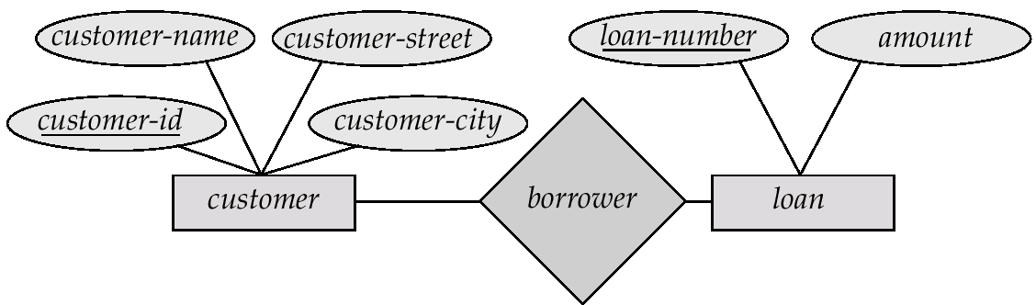
E-R Diagrams
Rectangles represent entity sets.
Diamonds represent relationship sets.
Lines link attributes to entity sets and entity sets to relationship sets.
Ellipses represent attributes
Double ellipses represent multivalued attributes.
Dashed ellipses denote derived attributes.
Underline indicates primary key attributes (will study later)

Slide 4
Entity Sets
A database can be modeled as a collection of entities or relationship among entities.
An entity is an object that exists and is distinguishable from other objects.
Example: specific person, company, event etc.
Entities have attributes
Example: people have names and addresses
An entity set is a set of entities of the same type that share the same properties.
Example: set of all persons, companies, trees, holidays

Slide 5
Attributes
An entity is represented by a set of attributes, that is descriptive properties possessed by all members of an entity set.
Domain is the set of permitted values for each attribute
Entity | Attributes
customer | customer-id, customer-name, customer-street, customer-city
loan | loan-number, amount

Slide 6
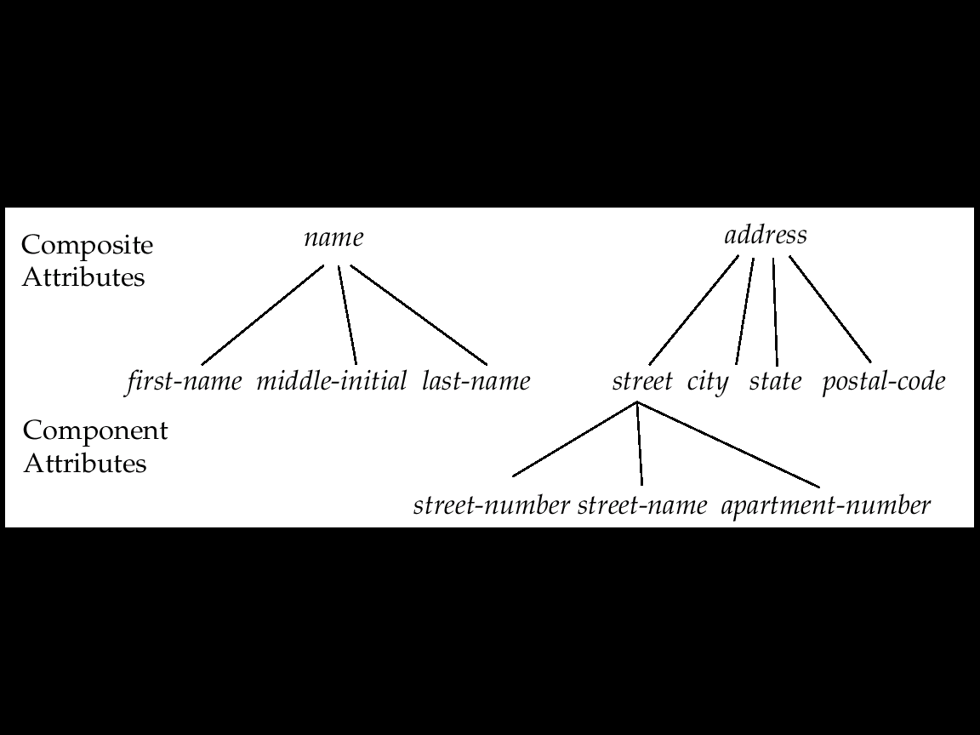
Attributes Types
Simple and composite attributes.
Single-valued and multi-valued attributes
E.g. multi-valued attribute: phone-numbers
Derived attributes can be computed from other attributes
E.g. age, given date of birth

Slide 7
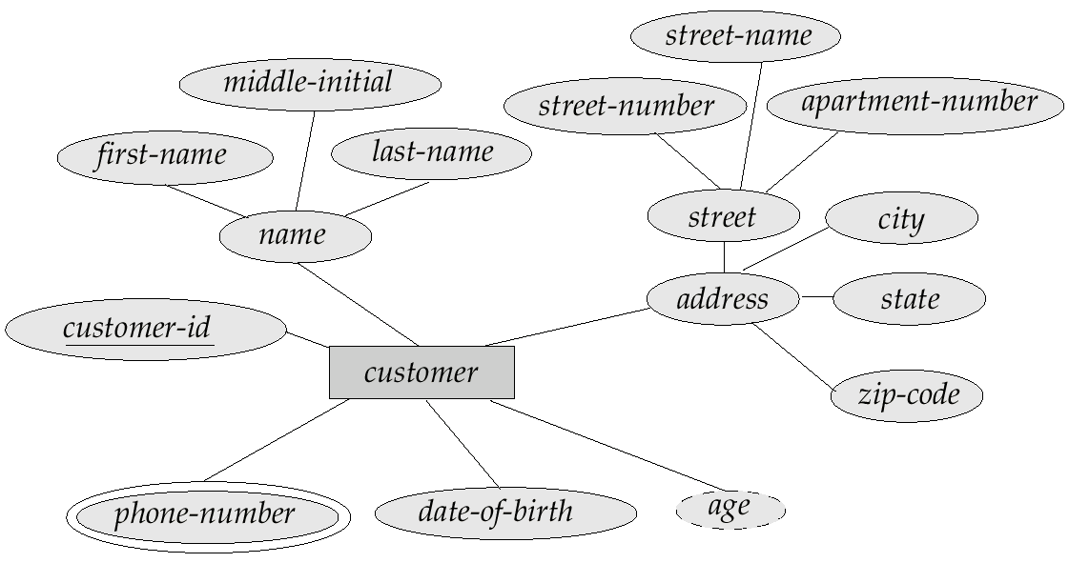
Composite, Multivalued &Derived Attributes

Slide 8
Relationship Sets
A relationship is an association among several entities
Example:
A relationship set is a mathematical relation among n ≥ 2 entities
An attribute can also be property of a relationship set.
Entity | Relationship | Entity
Sam | Deposit | A_102

Slide 9
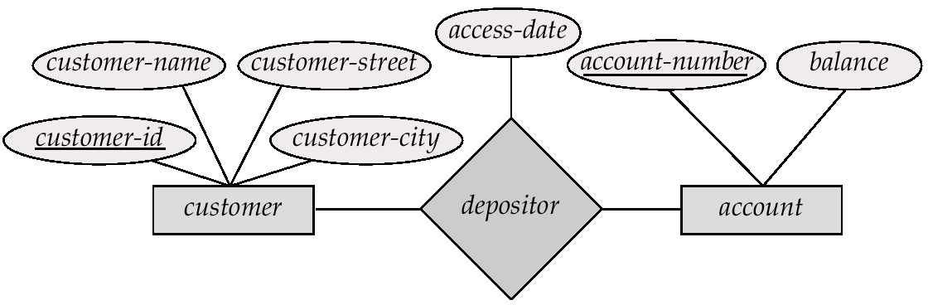
Relationship Sets with Attributes

Slide 10
Degree of a Relationship Set
Refers to number of entity sets that participate in a relationship set.
Relationship sets that involve two entity sets are binary (or degree two). Generally, most relationship sets in a database system are binary.
Relationship sets may involve more than two entity sets.
Relationships between more than two entity sets are rare. Most relationships are binary.

Slide 11
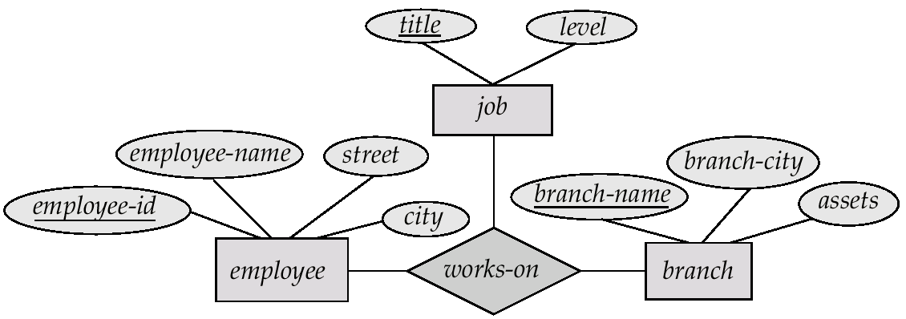
E-R Diagram with a Ternary Relationship

Slide 12
Mapping Cardinalities
Express the number of entities to which another entity can be associated via a relationship set.
Most useful in describing binary relationship sets.
Mapping Cardinalities affect ER Design
We express cardinality constraints by drawing either a directed line (→), signifying “one,” or an undirected line (—), signifying “many,” between the relationship set and the entity set.

Slide 13
Cardinality Type
For a binary relationship set the mapping cardinality must be one of the following types:
One to one
One to many
Many to one
Many to many

Slide 14
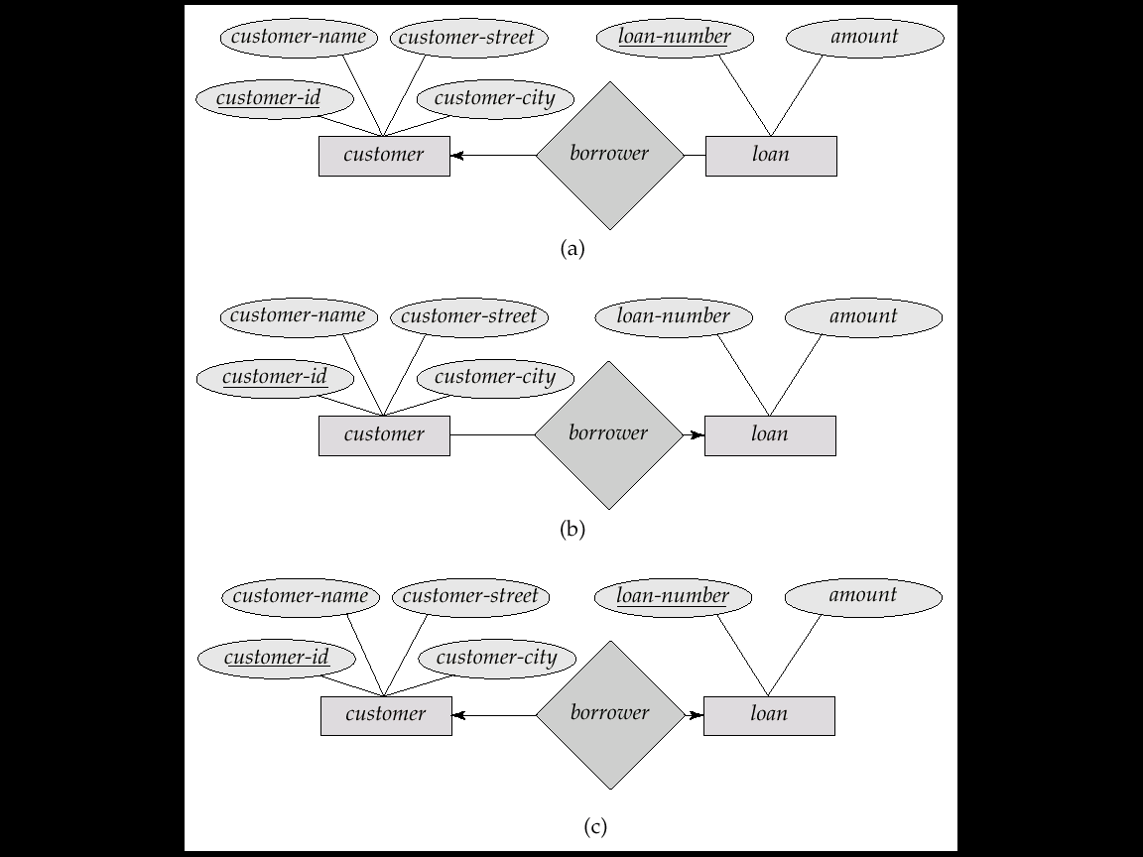
One-to-One relationship:
We express cardinality constraints by drawing either a directed line (→), signifying “one,” or an undirected line (—), signifying “many,” between the relationship set and the entity set.
E.g.: One-to-one relationship:
A customer is associated with at most one loan via the relationship borrower
A loan is associated with at most one customer via borrower

Slide 15
One-To-Many Relationship
In the one-to-many relationship a loan is associated with at most one customer via borrower, a customer is associated with several (including 0) loans via borrower

Slide 16
Many-To-One Relationships
In a many-to-one relationship a loan is associated with several (including 0) customers via borrower, a customer is associated with at most one loan via borrower

Slide 17
Many-To-Many Relationship
A customer is associated with several (possibly 0) loans via borrower
A loan is associated with several (possibly 0) customers via borrower

Slide 18
Draw ER Diagram From The Provided Scenario
In a library management system a member may rent many books. One
book may be rented by exactly one member. A member is identified by a
member number. The system also stores member name and address. A
member address is composed of house number, street name and city. A
book is identified by book ID. Book name, ISBN Number and edition of
a book are also stored. There may be multiple edition of a book. While
borrowing, the date of the borrowing and copy number of the book is
stored. A member may also reserve many books. A book may be
reserved by many members. To find the priority of the reservation the
date of making the reservation is also stored. A book is written by at
least one author. An author may write many books but the system
stores information of those authors of who has written at least one book stored
in the library. To identify an author the system stores author ID along with
author name. A book belongs to exactly one category and for a category there
must be at least one book. Each category has a name and the unique property of
each category is a category number.

Slide 19
THANK YOU

